Slide 1


Hii, Iam Siddhika
Welcome to Power BI Series
Part -26

Slide 2

Today Content
We focus only on the most used and important Dax Functions
I’m soo Excited.
Are you ready guys?
Meet DAX
COMMON FUNCTION CATEGORIES
2. LOGICAL FUNCTIONS
IF IFERROR AND
OR

Slide 3

LOGICAL FUNCTIONS
logical functions in DAX let you examine data and
make decisions based on that examination.
Have you got it?
For Example, with the IF function, you can check if a
condition is met in your data and then perform different actions based on whether it's true or false. It's like saying, "If this is true, do this; otherwise, do something else.

Slide 4


IF
The IF function in DAX evaluates a condition and returns one value if the condition is TRUE and another value if the condition is FALSE.
Try these
fucntions
Syntax
IF(<logical_test>, <value_if_true>[, <value_if_false>])
Suppose we want to categorize orders in the Orders table as "High" if the Profit is greater than $100 and "Low" otherwise. We can use the IF function for this:
Example
This DAX formula checks if the Profit in each row of the Orders table is greater than $100. If it is, it returns "High"; otherwise, it returns "Low".

Slide 5


IFERROR
The IFERROR function in DAX checks if a formula or expression results in an error and returns a specified value if an error occurs, otherwise, it returns the result of the formula or expression.
learn it?
Syntax
IFERROR(value, value_if_error)
Suppose we want to calculate the total revenue for all sales transactions in the Sales table. However, there might be cases where the Order Quantity or Unit Price is missing, resulting in errors. We want to handle these errors by displaying "No Data" instead.
Example
This DAX formula calculates the total revenue from all sales transactions in the Sales table by multiplying the Order Quantity and Unit Price for each row and then summing up the results. If there are any errors during this calculation (e.g., missing values), the IFERROR function returns "No Data" instead of an error message.

Slide 6

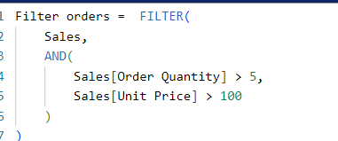
AND
The AND function in DAX evaluates multiple conditions and returns TRUE if all of the conditions are TRUE, otherwise, it returns FALSE.
check this?
Syntax
AND(<logical1>,<logical2>)
Example
Suppose we want to filter the Sales table to include only the rows where both the Order Quantity is greater than 5 and the UnitPrice is greater than $100.
This DAX formula filters the Sales table to include only the rows where both conditions (OrderQuantity > 5 and UnitPrice > $100) are true using the AND function.

Slide 7

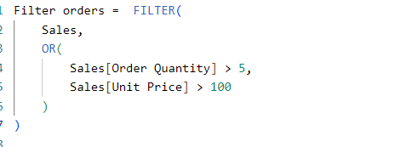
OR
The OR function in DAX evaluates multiple conditions and returns TRUE if at least one of the conditions is TRUE, otherwise, it returns FALSE.
Practice these
OR(<logical1>,<logical2>)
Syntax
Example
What are the orders where either the order quantity is greater than 5 or the unit price is greater than $100?
This DAX expression filters the Sales table to retrieve only the rows where either the order quantity is greater than 5 or the unit price is greater than $100. It uses the FILTER function to apply the condition specified within the OR function to each row of the Sales table, returning only the rows that meet the criteria.

Slide 8


Thank you for joining me today to learn about Part -26 of Power BI!
Remember, Learning DAX is key to unlocking the full potential of Power BI for insightful reporting and visualization.
Stay tuned for more insights and tips on Power BI in our next Series.
Follow
Siddhika Shah

